Slide 1
Firewall

Slide 2
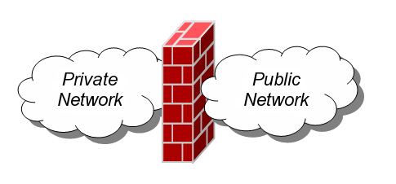
Firewalls
A firewall is an integrated collection of security measures designed to prevent unauthorized electronic access to a networked computer system.
A network firewall is similar to firewalls in building construction, because in both cases they are intended to isolate one "network" or "compartment" from another.

Slide 3
Firewall Design
Principles
The firewall is inserted between the premises network and the Internet
Aims:
  Establish a controlled link
  Protect the premises network from Internet-based attacks
  Provide a single choke point

Slide 4
Firewall Characteristics
Design goals:
  All traffic from inside to outside must pass through the firewall (physically blocking all access to the local network except via the firewall)
  Only authorized traffic (defined by the local security police) will be allowed to pass

Slide 5
Firewall Characteristics
Design goals:
  The firewall itself is immune to penetration (use of trusted system with a secure operating system)

Slide 6
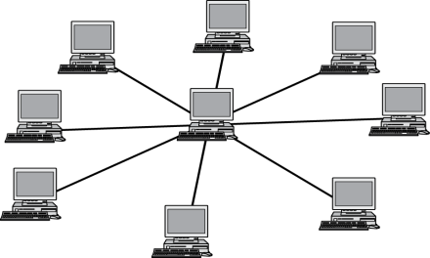
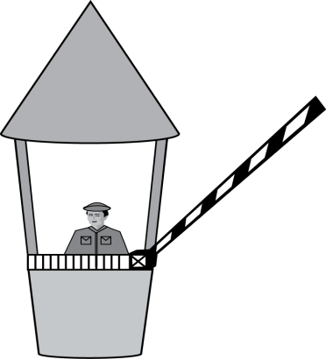
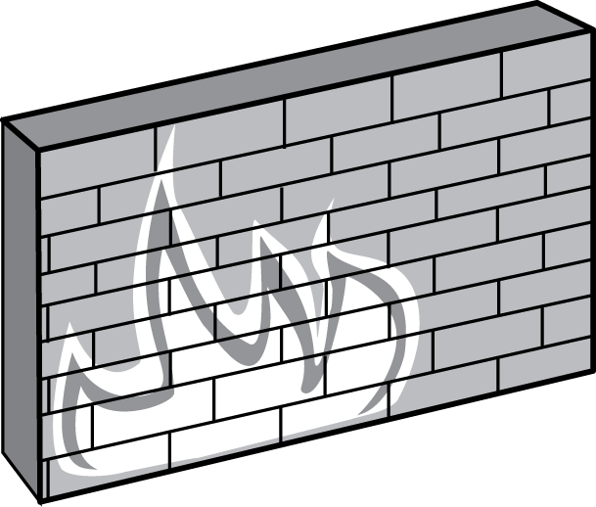


Firewall Policies
To protect private networks and individual machines from the dangers of the greater Internet, a firewall can be employed to filter incoming or outgoing traffic based on a predefined set of rules called firewall policies.
Trusted internal network
Firewall policies
Untrusted
Internet
Firewall

Slide 7
Policy Actions
Packets flowing through a firewall can have one of three outcomes:
  Accepted: permitted through the firewall
  Dropped: not allowed through with no indication of failure
  Rejected: not allowed through, accompanied by an attempt to inform the source that the packet was rejected
Policies used by the firewall to handle packets are based on several properties of the packets being inspected, including the protocol used, such as:
  TCP or UDP
  the source and destination IP addresses
  the source and destination ports
  the application-level payload of the packet (e.g., whether it contains a virus).

Slide 8
Blacklists and White Lists
Two fundamental approaches to creating firewall policies (or rulesets)
Blacklist approach (default-allow)
  All packets are allowed through except those that fit the rules defined specifically in a blacklist.
  Pros: flexible in ensuring that service to the internal network is not disrupted by the firewall
  Cons: unexpected forms of malicious traffic could go through
Whitelist approach (default-deny)
  Packets are dropped or rejected unless they are specifically allowed by the firewall
  Pros: A safer approach to defining a firewall ruleset
  Cons: must consider all possible legitimate traffic in rulesets

Slide 9
Firewall Types
packet filters (stateless)
  If a packet matches the packet filter's set of rules, the packet filter will drop or accept it
"stateful" filters
  it maintains records of all connections passing through it and can determine if a packet is either the start of a new connection, a part of an existing connection, or is an invalid packet.
application layer
  It works like a proxy it can “understand” certain applications and protocols.
  It may inspect the contents of the traffic, blocking what it views as inappropriate content (i.e. websites, viruses, vulnerabilities, ...)

Slide 10

Stateless Firewalls
A stateless firewall doesn’t maintain any remembered context (or “state”) with respect to the packets it is processing. Instead, it treats each packet attempting to travel through it in isolation without considering packets that it has processed previously.
SYN
Seq = x
Port=80
Client
SYN-ACK
Seq = y
Ack = x + 1
ACK
Seq = x + 1
Ack = y + 1
Trusted internal
network
Server
Firewall
Allow outbound SYN packets, destination port=80
Allow inbound SYN-ACK packets, source port=80

Slide 11


Stateless Restrictions
Stateless firewalls may have to be fairly restrictive in order to prevent most attacks.
Client
(blocked)
SYN
Seq = y
Port=80
Attacker
Trusted internal
network
Firewall
Allow outbound SYN packets, destination port=80
Drop inbound SYN packets,
Allow inbound SYN-ACK packets, source port=80

Slide 12
Statefull Firewalls
Stateful firewalls can tell when packets are part of legitimate sessions originating within a trusted network.
Stateful firewalls maintain tables containing information on each active connection, including the IP addresses, ports, and sequence numbers of packets.
Using these tables, stateful firewalls can allow only inbound TCP packets that are in response to a connection initiated from within the internal network.

Slide 13
Statefull Firewall Example
Allow only requested TCP connections:
76.120.54.101
SYN
Seq = x
Port=80
Server
128.34.78.55
Client
SYN-ACK
Seq = y
Ack = x + 1
ACK
Seq = x + 1
Ack = y + 1
Trusted internal
network
(blocked)
SYN-ACK
Seq = y
Port=80
Attacker
Allow outbound TCP sessions,
destination port=80
Firewall
Established TCP session:
(128.34.78.55, 76.120.54.101)
Firewall state table

Slide 14
TCP-based connections are easy to check
  TCP SYN packet
UDP-based traffic is not so clear
  There is no UDP connection set up
  Treat a UDP session starts when a legitimate UDP packet is allowed through the firewall (such as from inside to outside)
    Session is defined by (source IP, source port, dest IP, dest port)

Slide 15
Types of Firewalls
Three common types of Firewalls:
  Packet-filtering routers
  Application-level gateways
  Circuit-level gateways
  (Bastion host)

Slide 16
Types of Firewalls
Packet-filtering Router

Slide 17
Types of Firewalls
Packet-filtering Router
  Applies a set of rules to each incoming IP packet and then forwards or discards the packet
  Filter packets going in both directions
  The packet filter is typically set up as a list of rules based on matches to fields in the IP or TCP header
  Two default policies (discard or forward)

Slide 18
Types of Firewalls
Advantages:
  Simplicity
  Transparency to users
  High speed
Disadvantages:
  Difficulty of setting up packet filter rules
  Lack of Authentication

Slide 19
Types of Firewalls
Possible attacks and appropriate countermeasures
  IP address spoofing
  Source routing attacks
  Tiny fragment attacks

Slide 20
Types of Firewalls
Application-level Gateway

Slide 21
Types of Firewalls
Application-level Gateway
  Also called proxy server
  Acts as a relay of application-level traffic

Slide 22
Types of Firewalls
Advantages:
  Higher security than packet filters
  Only need to scrutinize a few allowable applications
  Easy to log and audit all incoming traffic
Disadvantages:
  Additional processing overhead on each connection (gateway as splice point)

Slide 23
Application-level Firewall
gateway-to-remote
host session
host-to-gateway
session
Filters packets on application data as well as on IP/TCP/UDP fields.
Example: allow select internal users to telnet outside.
application
gateway
router and filter
1. Require all telnet users to telnet through gateway.
2. For authorized users, gateway sets up telnet connection to dest host. Gateway relays data between 2 connections
3. Router filter blocks all telnet connections not originating from gateway.
Example: block user access to know porn websites
  Check if the Web URL is in a “black-list”

Slide 24
Types of Firewalls
Circuit-level Gateway

Slide 25
Types of Firewalls
Circuit-level Gateway
  Stand-alone system or
  Specialized function performed by an Application-level Gateway
  Sets up two TCP connections
  The gateway typically relays TCP segments from one connection to the other without examining the contents

Slide 26
Types of Firewalls
Circuit-level Gateway
  The security function consists of determining which connections will be allowed
  Typically use is a situation in which the system administrator trusts the internal users
  An example is the SOCKS package

